Slide 1
3. Independence and Random Variables

Slide 2
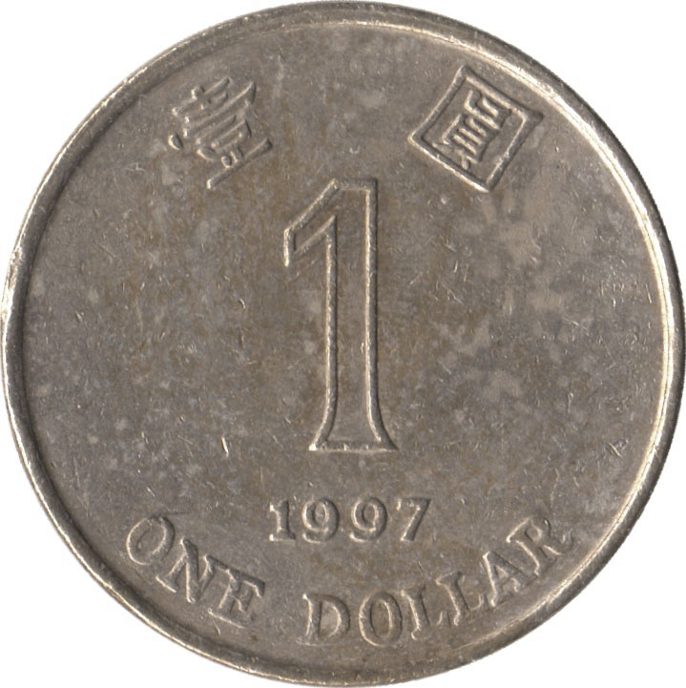
Independence of two events
Let E₁ be “first coin comes up H”
E₂ be “second coin comes up H”
Then P(E₂ | E₁) = P(E₂)
P(E₂∩E₁) = P(E₂)P(E₁)
Events A and B are independent if
P(A∩B) = P(A) P(B)

Slide 3

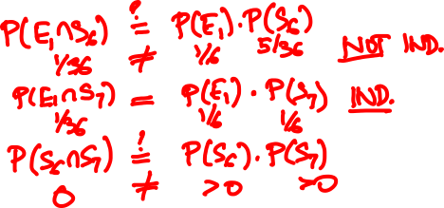
Examples of (in)dependence
Let E₁ be “first die is a 4”
S₆ be “sum of dice is a 6”
S₇ be “sum of dice is a 7”
E₁ and S₆?
E₁ and S₇?
S₆ and S₇?
Notes:
0

Slide 4
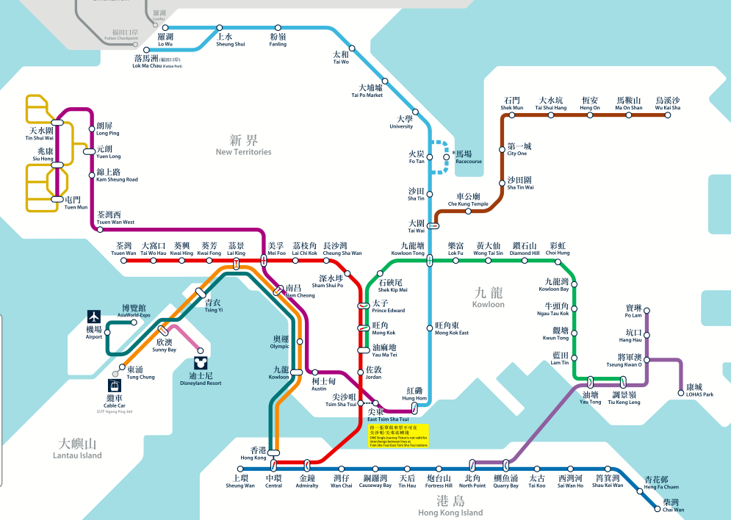
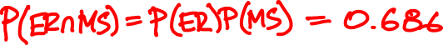
Sequential components
ER: “East Rail Line is working”
P(ER) = 70%
MS: “Ma On Shan Line is working”
P(MS) = 98%

Slide 5
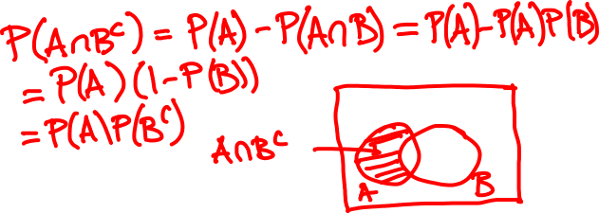
Algebra of independent events
If A and B are independent, then A and B^{c} are also independent.
Proof:

Slide 6
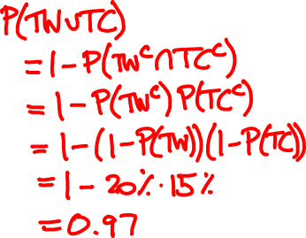
Parallel components
TW: “Tsuen Wan Line is operational”
P(TW) = 80%
TC: “Tung Chung Line is operational”
P(TC) = 85%

Slide 7
Independence of three events
Events A, B, and C are independent if
P(A∩B) = P(A) P(B)
P(B∩C) = P(B) P(C)
P(A∩C) = P(B) P(C)
and P(A∩B∩C) = P(A) P(B) P(C).

Slide 8
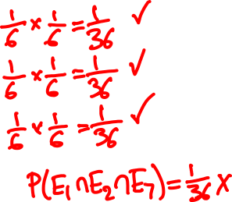
(In)dependence of three events
Let E₁ be “first die is a 4”
E₂ be “second die is a 3”
S₇ be “sum of dice is a 7”
1/6
E₁, E₂?
E₁
E₁, S₇?
1/36
E₂
S₇
E₂, S₇?
1/6
1/6
E₁, E₂, S₇?
Notes:
This example shows pairwise independence not enough for independence

Slide 9
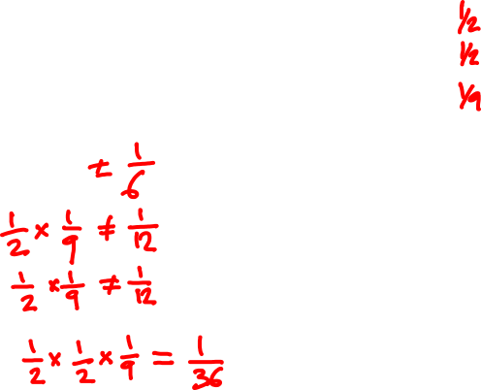
(In)dependence of three events
Let A be “first roll is 1, 2, or 3 ”
B be “first roll is 3, 4, or 5”
C be “sum of rolls is 9”
A, B?
A, C?
B, C?
A, B, C?
Notes:
This example shows P(ABC) = P(A)P(B)P(C) can hold but A, B, C still not independent

Slide 10
Independence of many events
Events A₁, A₂, … are independent if for every subset of the events, the probability of the intersection is the product of their probabilities.
Algebra of independent events
Independence is preserved if we replace some event(s) by their complements, intersections, unions

Slide 11
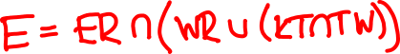
Multiple components
P(ER) = 70%
P(WR) = 75%
P(TW) = 85%
P(KT) = 95%

Slide 12
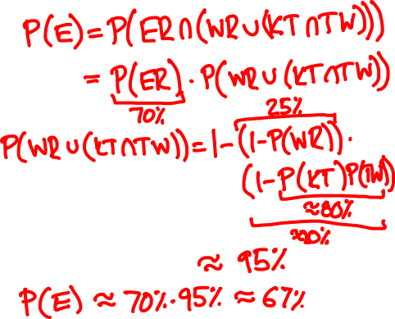
Multiple components
P(ER) = 70%
P(WR) = 75%
P(KT) = 95%
P(TW) = 85%

Slide 13

Playoffs
Alice wins 60% of her ping pong matches against Bob. They meet for a 3 match playoff. What are the chances that Alice will win the playoff?
Probability model
Let A_{i} be the event Alice wins match i
Assume P(A₁) = P(A₂) = P(A₃) = 0.6
Also assume A₁, A₂, A₃ are independent
Notes:
Point out without proof that this is a valid definition of a probability model: You can calculate the probability of any outcome, and this is consistent with the axioms of probability

Slide 14
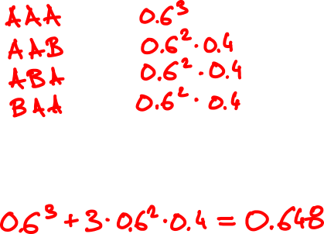
Playoffs
outcome
probability
P(A) =

Slide 15
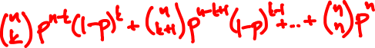
Bernoulli trials
n trials, each succeeds independently with
probability p
The probability at least k out of n succeed is

Slide 16
Playoffs
p = 0.6
p = 0.7
n
n
The probability that Alice wins an n game tournament

Slide 17

The Lakers and the Celtics meet for a 7-game playoff. They play until one team wins four games.
Suppose the Lakers win 60% of the time. What is the probability that all 7 games are played?

Slide 18
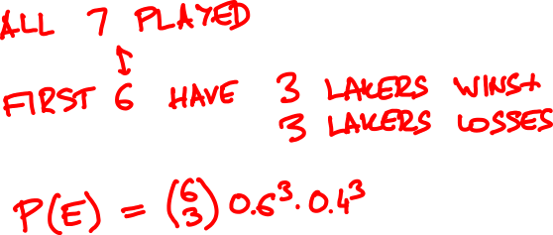

Slide 19
Conditional independence
A and B are independent conditioned on F if
P(A ∩ B | F) = P(A | F) P(B | F)
Alternative definition:
P(A | B ∩ F) = P(A | F)

Slide 20
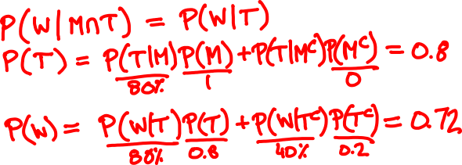
today
tomorrow
☀️
80% ☀️, 20% 🌧
🌧
40% ☀️, 60% 🌧
It is ☀️ on Monday. Will it 🌧 on Wednesday?

Slide 21
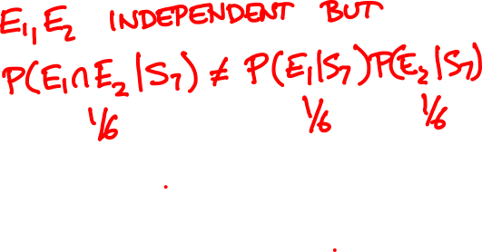
Conditioning does not preserve independence
Let E₁ be “first die is a 4”
E₂ be “second die is a 3”
S₇ be “sum of dice is a 7”
Notes:
E1, E2 are independent, but dependent conditioned on S7

Slide 22


Slide 23
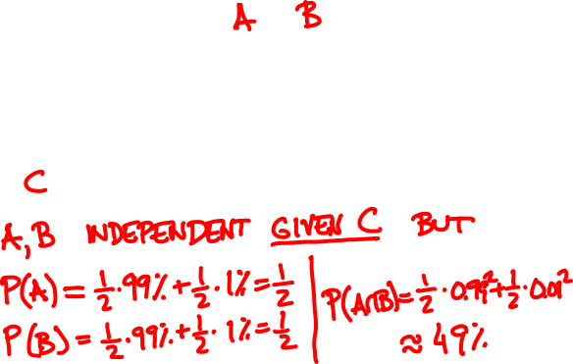
Conditioning may destroy dependence
Probability model
🙎🏻‍♂️
🙍🏻‍♀️
🇺🇸
👍
👍
99%
👎
👎
1%
🇨🇳
Notes:
The events A = “Alice likes the movie” and B = ”Bob likes the movie” are conditionally independent, but unconditionally dependent P(A and B) = ½ * .99^2 + ½ * .01^2 very close to ½, P(A) = P(B) = 1/2

Slide 24
Random variable
A discrete random variable assigns a discrete value to every outcome in the sample space.
Example
{ HH, HT, TH, TT }
N = number of Hs

Slide 25
Probability mass function
The probability mass function (p.m.f.) of discrete random variable X is the function
p(x) = P(X = x)
Example
{ HH, HT, TH, TT }
¼
¼
¼
¼
N = number of Hs
p(0) = P(N = 0) = P({TT}) = 1/4
p(1) = P(N = 1) = P({HT, TH}) = 1/2
p(2) = P(N = 2) = P({HH}) = 1/4

Slide 26
Probability mass function
We can describe the p.m.f. by a table or by a chart.
x 0 1 2
p(x)
p(x) ¼ ½ ¼
x

Slide 27

Two six-sided dice are tossed. Calculate the p.m.f. of the difference D of the rolls.
What is the probability that D > 1? D is odd?

Slide 28
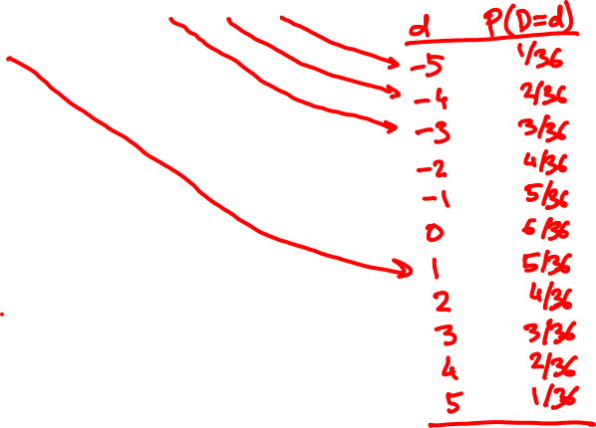
11 12 13 14 15 16
21 22 23 24 25 26
31 32 33 34 35 36
41 42 43 44 45 46
51 52 53 54 55 56
61 62 63 64 65 66

Slide 29

The binomial random variable
Binomial(n, p): Perform n independent trials, each of which succeeds with probability p.
X = number of successes
Examples
Toss n coins. “number of heads” is Binomial(n, ½).
Toss n dice. “Number of s” is Binomial(n, 1/6).

Slide 30
A less obvious example
Toss n coins. Let C be the number of consecutive changes (HT or TH).
Examples:
ω
C(ω)
HHHHHHH
0
THHHHHT
2
HTHHHHT
3
Then C is Binomial(n – 1, ½).

Slide 31
A non-example
Draw a 10-card hand from a 52-card deck.
Let N = number of aces among the drawn cards
Is N a Binomial(10, 1/13) random variable?
No!
Trial outcomes are not independent.

Slide 32
Probability mass function
If X is Binomial(n, p), its p.m.f. is
n
(
)
p(k) = P(X = k) = p^{k} (1 - p)^{n-k}
k

Slide 33
Binomial(10, 0.5)
Binomial(50, 0.5)
Binomial(10, 0.3)
Binomial(50, 0.3)

Slide 34
Geometric random variable
Let X₁, X₂, … be independent trials with success p.
A Geometric(p) random variable N is the time of the first success among X₁, X₂, … :
N = first (smallest) n such that X_{n} = 1.
So P(N = n) = P(X₁ = 0, …, X_{n-1} = 0, X_{n} = 1)
= (1 – p)^{n-1}p.
This is the p.m.f. of N.

Slide 35
Geometric(0.5)
Geometric(0.7)
Geometric(0.05)

Slide 36




Apples
About 10% of the apples on your farm are rotten.
You sell 10 apples. How many are rotten?
Probability model
Number of rotten apples you sold is Binomial(n = 10, p = 1/10).

Slide 37

Apples
You improve productivity; now only 5% apples rot.
You can now sell 20 apples.
N is now Binomial(20, 1/20).

Slide 38
.387
Binomial(10, 1/10)
.349
.194
.001
10⁻¹⁰
.377
.354
Binomial(20, 1/20)
.189
.002
10⁻⁸
10⁻²⁶
.367
.367
Poisson(1)
.183
.003
10⁻⁷
10⁻¹⁹

Slide 39
The Poisson random variable
A Poisson(λ) random variable has this p.m.f.:
p(k) = e^{-λ} λ^{k}/k!
k = 0, 1, 2, 3, …
Poisson random variables do not occur “naturally” in the sample spaces we have seen.
They approximate Binomial(n, p) random variables when λ = np is fixed and n is large (so p is small)
p_{Poisson(λ)}(k) = lim_{n → ∞} p_{Binomial(n, λ/n)}(k)

Slide 40
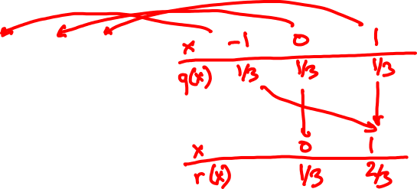
Functions of random variables
p.m.f. of X:
p.m.f. of X – 1?
x
0 1 2
p(x)
1/3 1/3 1/3
p.m.f. of (X – 1)²?
If X is a random variable with p.m.f. p_{X},
then Y = f(X) is a random variable with p.m.f.
p_{Y}(y) = ∑_{x: f(x) = y} p_{X}(x).

Slide 41
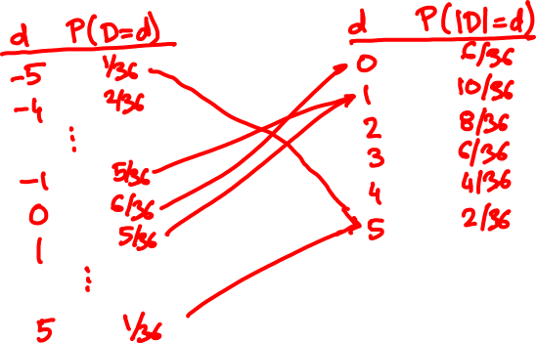
Two six-sided dice are tossed. D is the difference of rolls. Calculate the p.m.f. of |D|.

